Slide 1
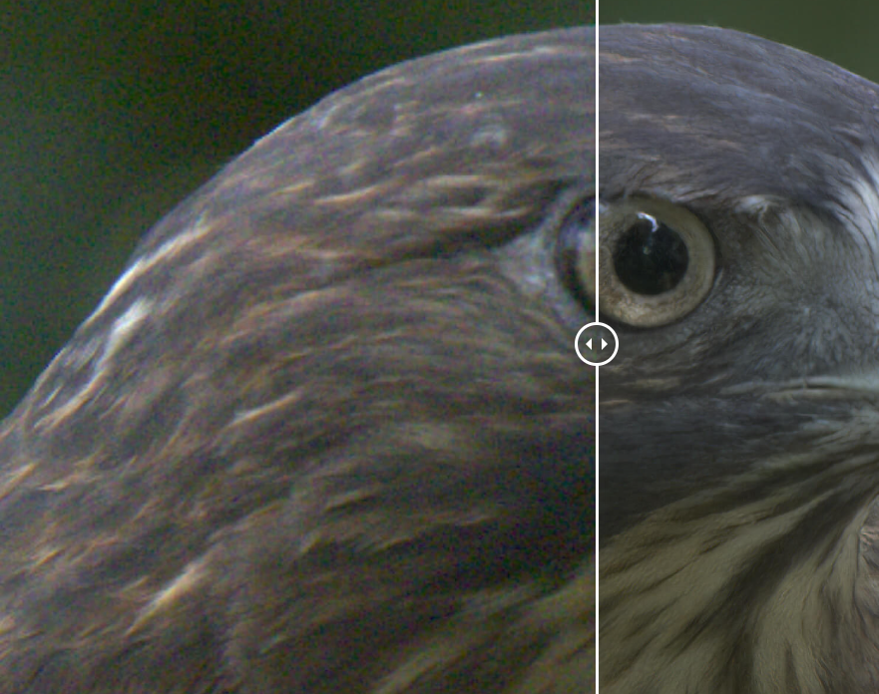
GAN Image Denoising
Tiansheng Wang
‘Introduction to Scientific Computing’

Slide 2
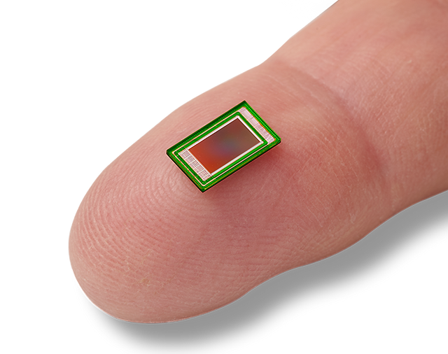
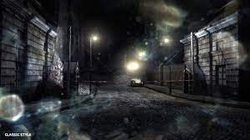
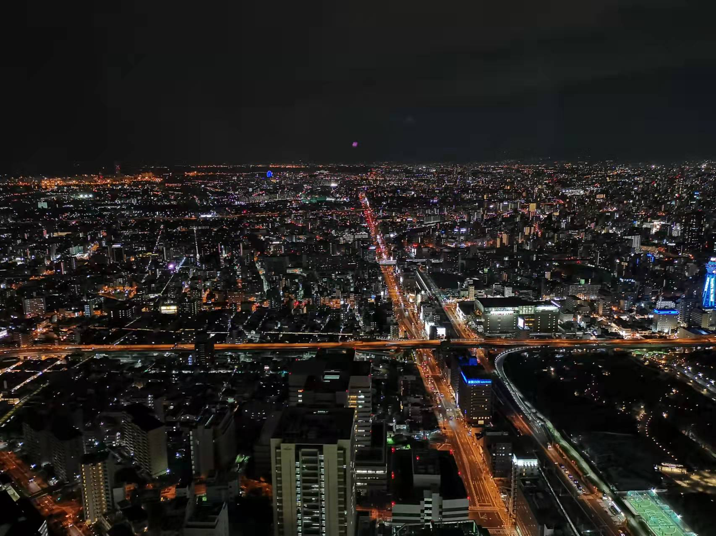
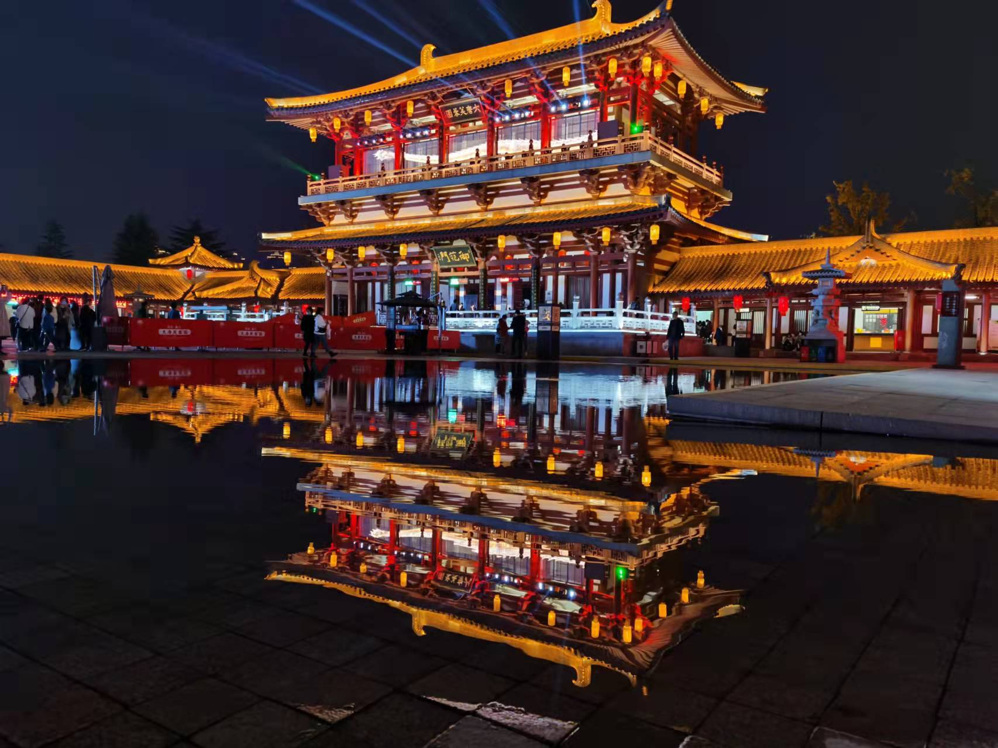
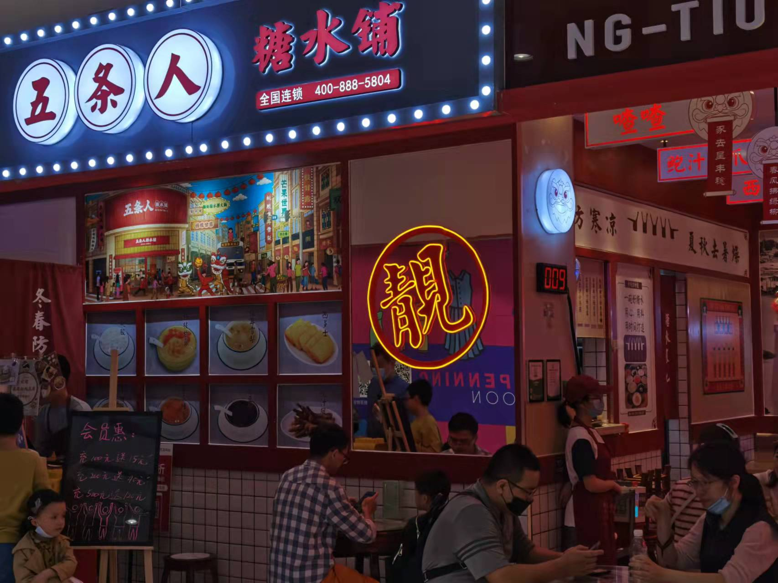
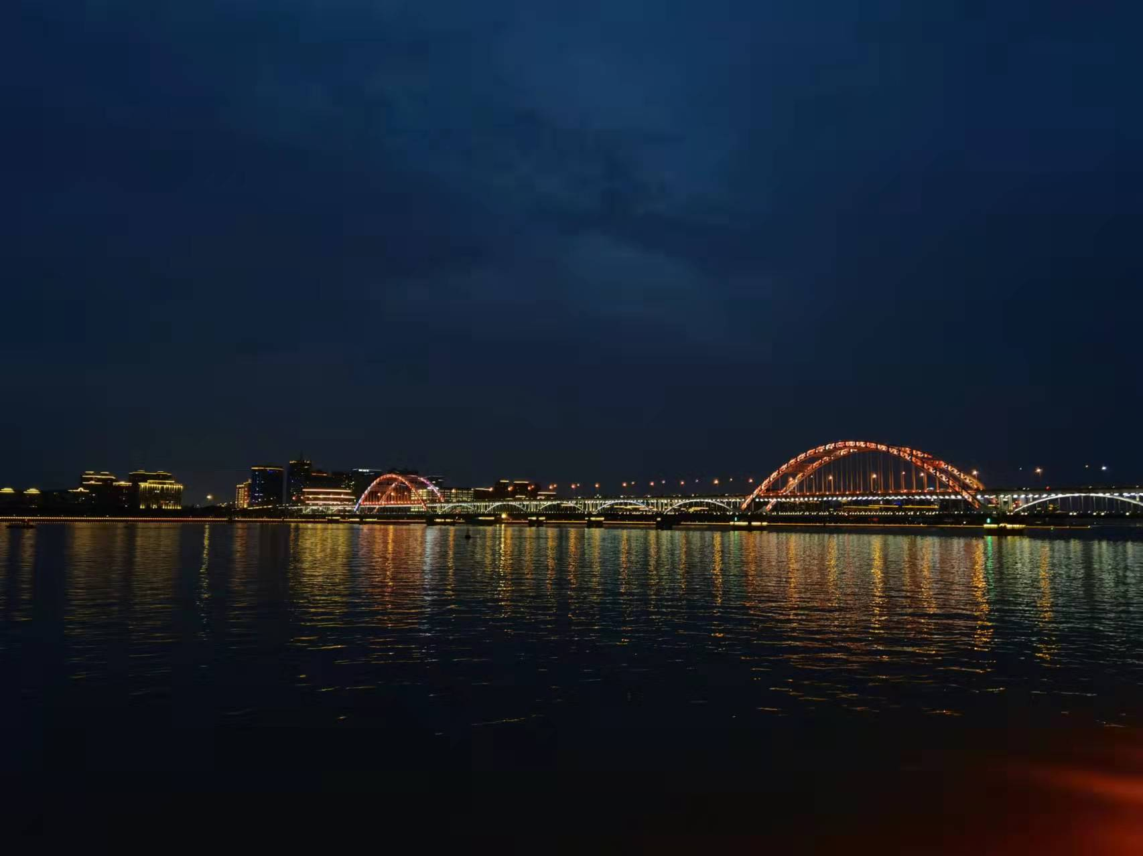
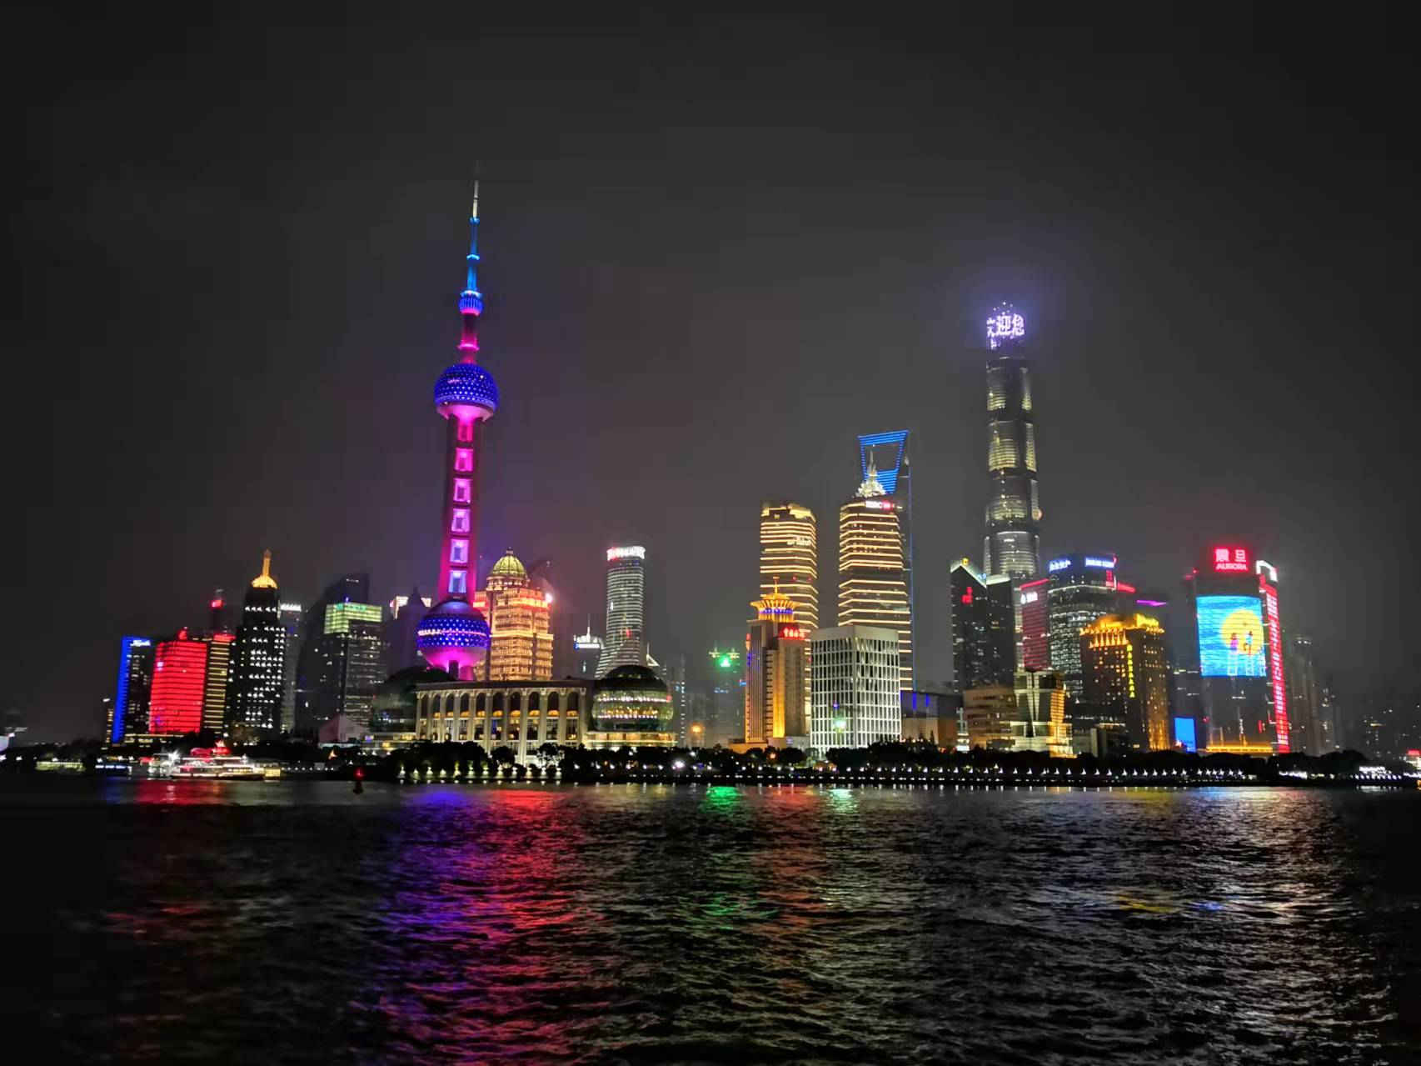
Introduction
Where does the image noise come from?
Sensor limitations
(cannot obtain enough light)
Environmental Factors
(dust on the lens)
Denoising -- Break the sensor limitations to gain better image quality

Slide 3
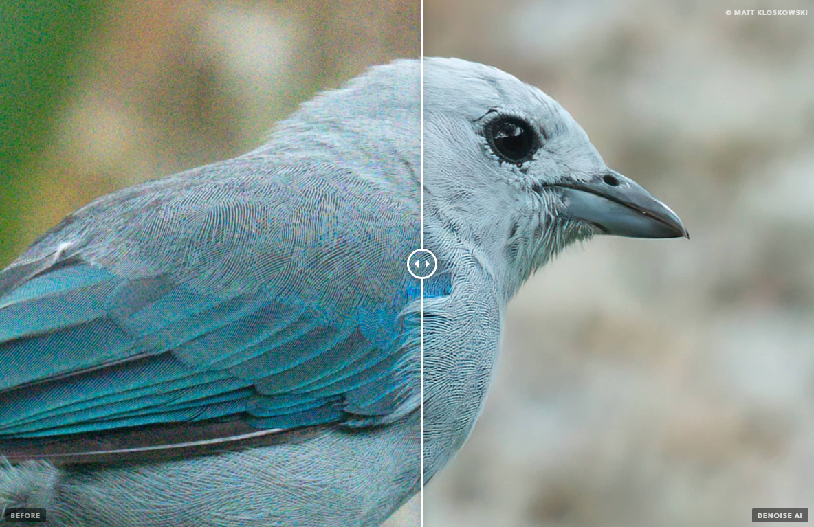
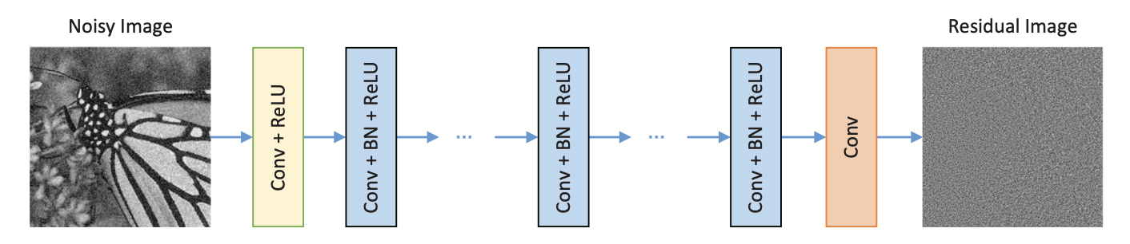
Background
Traditional methods using filters:
mean, median, biliteral, wavelet filtering
Non-local-mean, BM3D(2010)
Neural network methods:
CNNs: Deep Denoising CNN(DnCNN)
GANs: Noise2Noise (N2N) / CycleGAN
Newer… Transformers
https://www.topazlabs.com/denoise-ai
DnCNN Network

Slide 4
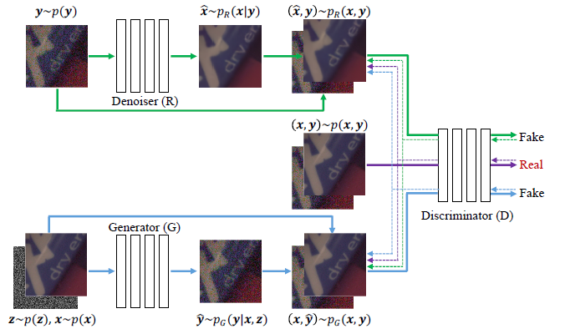
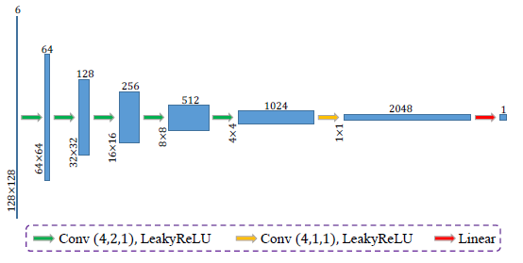
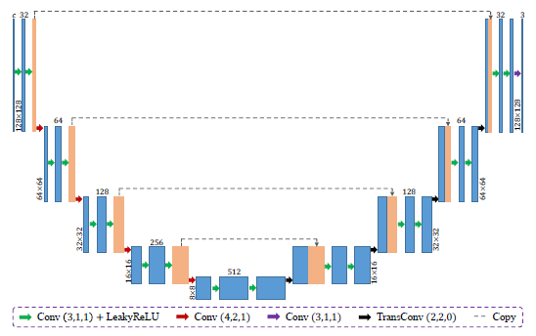
Network Structure
Discriminator
Overall Network Structure
3 components
Train end-to-end
Yue, Zongsheng, Qian Zhao, Lei Zhang, and Deyu Meng. "Dual adversarial network: Toward real-world noise removal and noise generation." In Computer Vision–ECCV 2020: 16th European Conference, Glasgow, UK, August 23–28, 2020, Proceedings, Part X 16, pp. 41-58. Springer International Publishing, 2020.
Denoiser & Generator

Slide 5
Training
Datasets
SIDD: Smartphone Image Denoising Dataset(2018)
Images captured by 5 different smartphones
Aligned noisy / ground-truth image pairs(use image sequences to obtain high-quality gt)
Data Augmentation
Random Crop / Flip / Rotate(90/180/270)
No arbitrary rotation and global color or light adjustment augmentation
Training progress
Trained on a local desktop with GPU/CUDA acceleration(i7 12700k + RTX 4090)
50 epochs / AdamW Optimizer / batch size 16
Cost about 6.5 hours
Loss on validation set during training

Slide 6
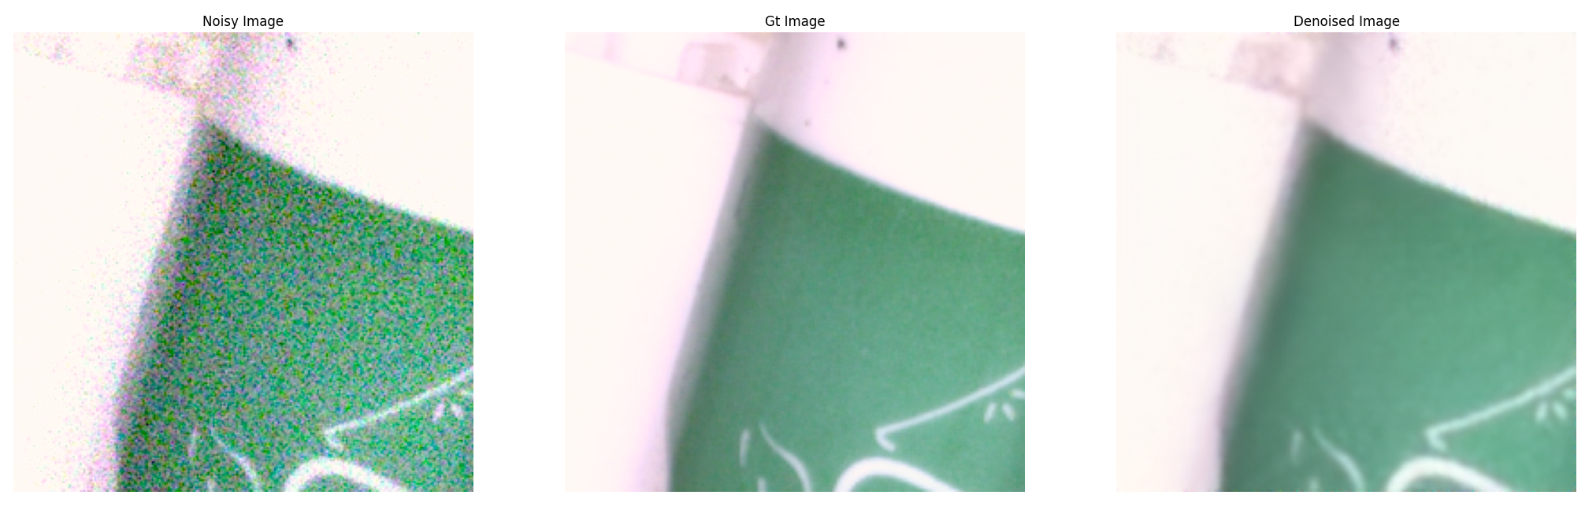
Results
Results on validation datasets
Noise has been removed.

Slide 7
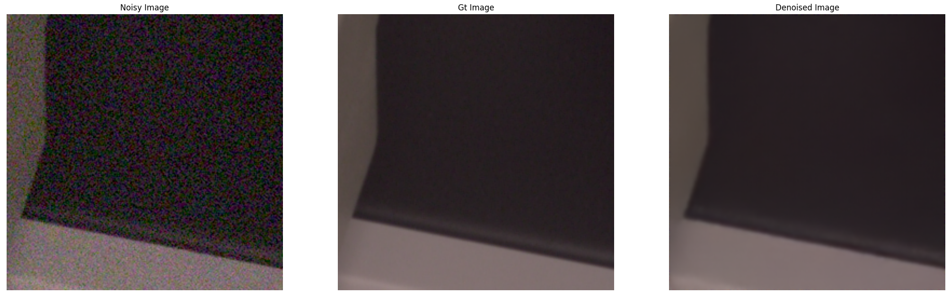
Results
Results on validation datasets
Noise has been removed.

Slide 8
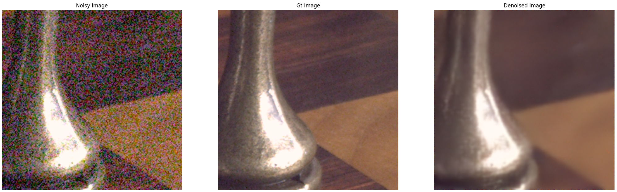
Results
Results on validation datasets
Noise has been removed.

Slide 9
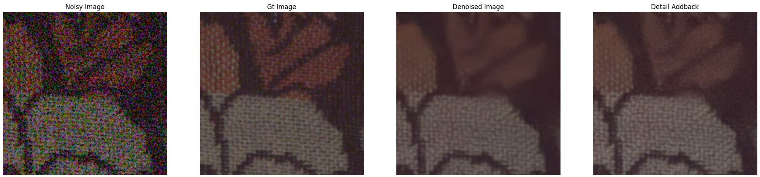
Discussions
Better metrics on image quality
Cleaner, better?

Slide 10

Thank you for listening

